Slide 1
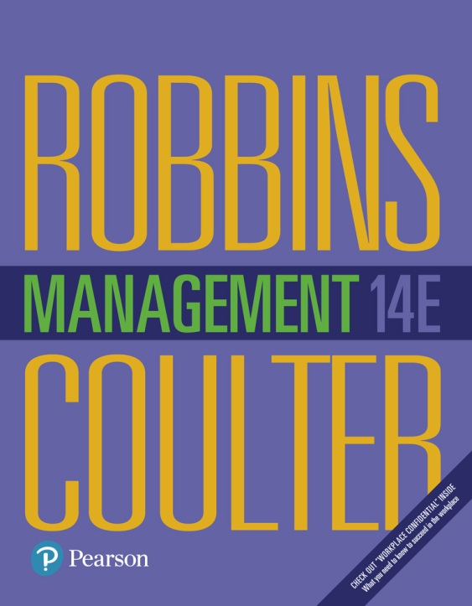
Management
Fourteenth Edition
Chapter 11
Designing Organizational Structure
Copyright © 2018, 2016, 2014 Pearson Education, Inc. All Rights Reserved

Slide 2
Learning Objectives
11.1 Describe six key elements in organizational design.
11.2 Contrast mechanistic and organic structures.
11.3 Discuss the contingency factors that favor either the mechanistic model or the organic model of organizational design.
11.4 Describe traditional organizational design options.
11.5 Discuss organizing flexibility in the twenty-first century.
Develop your skill at acquiring and using power.
Know how to stay connected and “in the loop” when working remotely.

Slide 3
Elements of Organizational Design
Organizing: management function that involves arranging and structuring work to accomplish the organization’s goals
Organizational structure: the formal arrangement of jobs within an organization
Organizational chart: the visual representation of an organization’s structure
Organizational design: creating or changing an organization’s structure
Notes:
Organizing is arranging and structuring work to accomplish organizational goals. It’s an important process during which managers design an organization’s structure.
Organizational structure is the formal arrangement of jobs within an organization.
Structure can be shown visually in an organizational chart (see Exhibit 11-1).
When managers create or change the structure, they’re engaged in organizational design, a process that involves decisions about six key elements: work specialization, departmentalization, chain of command, span of control, centralization and decentralization, and formalization.

Slide 4
Exhibit 11-1 Purposes of Organizing
Purposes
Divides work to be done into specific jobs and departments.
Assigns tasks and responsibilities associated with individual jobs.
Coordinates diverse organizational tasks.
Clusters jobs into units.
Establishes relationships among individuals, groups, and departments.
Establishes formal lines of authority.
Allocates and deploys organizational resources.

Slide 5
When managers create or change the structure, they’re engaged in organizational design, a process that involves decisions about six key elements:
work specialization,
departmentalization,
chain of command,
span of control,
centralization and decentralization, and
formalization.

Slide 6
Work Specialization
Work specialization: dividing work activities into separate job tasks
Notes:
Work specialization is dividing work activities into separate job tasks. Individual employees “specialize” in doing part of an activity rather than the entire activity in order to increase work output. It’s also known as division of labor. Work specialization makes efficient use of the diversity of workers skills.
Early proponents of work specialization believed it could lead to great increases in productivity. At the beginning of the twentieth century, that generalization was reasonable. Because specialization was not widely practiced, its introduction almost always generated higher productivity.

Slide 7
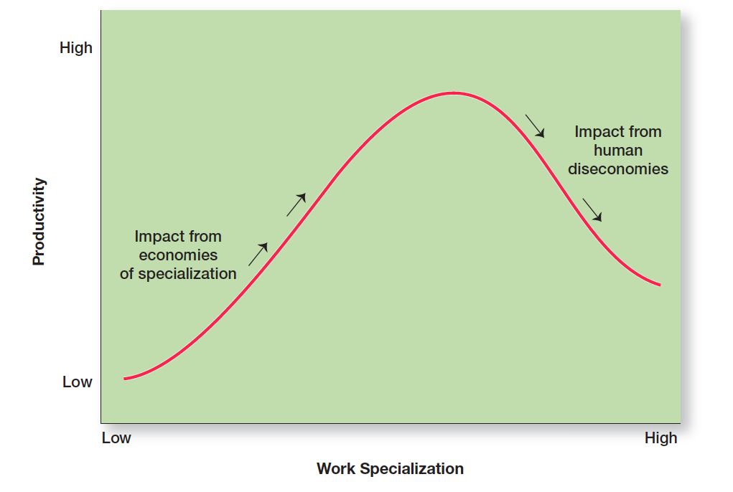
Exhibit 11-2 Economies and Diseconomies of Work Specialization
Exhibit 11-2 shows the economies and diseconomies of work specialization.
Notes:
But, as Exhibit 11-2 illustrates, a good thing can be carried too far. At some point, the human diseconomies from division of labor—boredom, fatigue, stress, low productivity, poor quality, increased absenteeism, and high turnover—exceed the economic advantages.
Most managers today continue to see work specialization as important because it helps employees be more efficient. At some point, however, work specialization no longer leads to productivity.

Slide 8
Departmentalization
Departmentalization: the basis by which jobs are grouped together
Five common forms of departmentalization are used, although an organization may develop its own unique classifcation.
Notes:
How jobs are grouped together is called departmentalization. Five common forms of departmentalization are used, although an organization may develop its own unique classification. Exhibit 11-3 illustrates each type of departmentalization as well as the advantages and disadvantages of each.

Slide 9
Exhibit 11-3 The Five Common Forms of Departmentalization (1 of 3)
Exhibit 11-3 illustrates each type of departmentalization as well as the advantages and disadvantages of each.

Slide 10
Exhibit 11-3 The Five Common Forms of Departmentalization (2 of 3)
Exhibit 11-3 illustrates each type of departmentalization as well as the advantages and disadvantages of each.

Slide 11
Exhibit 11-3 The Five Common Forms of Departmentalization (3 of 3)
Exhibit 11-3 illustrates each type of departmentalization as well as the advantages and disadvantages of each.

Slide 12
Cross-Functional Team
Cross-functional team: a work team composed of individuals from various functional specialties
Notes:
Another popular trend is the use of teams, especially as work tasks have become more complex and diverse skills are needed to accomplish those tasks. One specific type of team that more organizations are using is a cross-functional team, a work team composed of individuals from various functional specialties.

Slide 13
Chain of Command
Chain of command: the line of authority extending from upper organizational levels to the lowest levels, which clarifies who reports to whom
Notes:
People need to know who their boss is. That’s what the chain of command is all about. The chain of command is the line of authority extending from upper organizational levels to lower levels, which clarifies who reports to whom. Managers need to consider it when organizing work because it helps employees with questions such as “Who do I report to?” or “Who do I go to if I have a problem?” To understand the chain of command, you have to understand three other important concepts: authority, responsibility, and unity of command.

Slide 14
Authority
Authority: The rights inherent in a managerial position to tell people what to do and to expect them to do it.
Line authority: authority that entitles a manager to direct the work of an employee
Staff authority: positions with some authority that have been created to support, assist, and advise those holding line authority
Notes:
Authority refers to the rights inherent in a managerial position to tell people what to do and to expect them to do it. Managers in the chain of command have authority to do their job of coordinating and overseeing the work of others. Authority can be delegated downward to lower-level managers, giving them certain rights while also prescribing certain limits within which to operate.
Line authority entitles a manager to direct the work of an employee. It is the employer–employee authority relationship that extends from the top of the organization to the lowest echelon, according to the chain of command, as shown in Exhibit 11-4. As a link in the chain of command, a manager with line authority has the right to direct the work of employees and to make certain decisions without consulting anyone.
As organizations get larger and more complex, line managers find that they do not have the time, expertise, or resources to get their jobs done effectively. In response, they create staff authority functions to support, assist, advise, and generally reduce some of their informational burdens. For instance, a hospital administrator who cannot effectively handle the purchasing of all the supplies the hospital needs creates a purchasing department, which is a staff function.

Slide 15
Responsibility
Responsibility: the obligation or expectation to perform any assigned duties
Unity of command: the management principle that each person should report to only one manager
Notes:
When managers use their authority to assign work to employees, those employees take on an obligation to perform those assigned duties. This obligation or expectation to perform is known as responsibility. And employees should be held accountable for their performance! Assigning work authority without responsibility and accountability can create opportunities for abuse. Likewise, no one should be held responsible or accountable for work tasks over which he or she has no authority to complete.
Finally, the unity of command principle (one of Fayol’s 14 management principles) states that a person should report to only one manager. Without unity of command, conflicting demands from multiple bosses may create problems.

Slide 16
Span of Control
Span of control: the number of employees a manager can efficiently and effectively manage
Notes:
The traditional view was that managers could not—and should not—directly supervise more than five or six subordinates. Determining the span of control is important because, to a large degree, it determines the number of levels and managers in an organization—an important consideration in how efficient an organization will be.
The contemporary view of span of control recognizes there is no magic number. Many factors influence the number of employees a manager can efficiently and effectively manage. The trend in recent years has been toward larger spans of control, which is consistent with managers’ efforts to speed up decision making, increase flexibility, get closer to customers, empower employees, and reduce costs. Managers are beginning to recognize that they can handle a wider span when employees know their jobs well and when those employees understand organizational processes.

Slide 17
Exhibit 11-4 Contrasting Spans of Controls
As Exhibit 11-4 shows, if one organization has a span of four and the other a span of eight, the organization with the wider span will have two fewer levels and approximately 800 fewer managers.
Notes:
Assume two organizations both have approximately 4,100 employees. As Exhibit 11-4 shows, if one organization has a span of four and the other a span of eight, the organization with the wider span will have two fewer levels and approximately 800 fewer managers. At an average manager’s salary of $62,000 a year, the organization with the wider span would save over $49 million a year! Obviously, wider spans are more efficient in terms of cost. However, at some point, wider spans may reduce effectiveness if employee performance worsens because managers no longer have the time to lead effectively.

Slide 18
Centralization and Decentralization
Centralization: the degree to which decision making is concentrated at upper levels of the organization
Decentralization: the degree to which lower-level employees provide input or actually make decisions
Notes:
If top managers make key decisions with little input from below, then the organization is more centralized. On the other hand, the more that lower-level employees provide input or actually make decisions, the more decentralization there is. Keep in mind that centralization–decentralization is not an either-or concept. The decision is relative, not absolute—that is, an organization is never completely centralized or decentralized.

Slide 19
Exhibit 11-5 Centralization or Decentralization
More Centralization | More Decentralization
Environment is stable. | Environment is complex, uncertain.
Lower-level managers are not as capable or experienced at making decisions as upper-level managers. | Lower-level managers are capable and experienced at making decisions.
Lower-level managers do not want a say in decisions. | Lower-level managers want a voice in decisions.
Decisions are relatively minor. | Decisions are significant.
Organization is facing a crisis or the risk of company failure. | Corporate culture is open to allowing managers a say in what happens.
Company is large. | Company is geographically dispersed.
Effective implementation of company strategies depends on managers retaining say over what happens. | Effective implementation of company strategies depends on managers having involvement and flexibility to make decisions.
Notes:
Exhibit 11-5 lists some of the factors that affect an organization’s use of centralization or decentralization.

Slide 20
Employee Empowerment
Employee empowerment: giving employees more authority (power) to make decisions
Notes:
As organizations have become more flexible and responsive to environmental trends, there’s been a distinct shift toward decentralized decision-making. This trend, also known as employee empowerment, gives employees more authority (power) to make decisions. (We’ll address this concept more thoroughly in our discussion of leadership in Chapter 17.) In large companies especially, lower-level managers are “closer to the action” and typically have more detailed knowledge about problems and how best to solve them than top managers.

Slide 21
Formalization
Formalization: how standardized an organization’s jobs are and the extent to which employee behavior is guided by rules and procedures
Notes:
In highly formalized organizations, there are explicit job descriptions, numerous organizational rules, and clearly defined procedures covering work processes. Employees have little discretion over what’s done, when it’s done, and how it’s done. However, where there is less formalization, employees have more discretion in how they do their work.
Although some formalization is necessary for consistency and control, many organizations today rely less on strict rules and standardization to guide and regulate employee behavior.

Slide 22
Mechanistic and Organic Structures
Mechanistic organization: an organizational design that’s rigid and tightly controlled
Organic organization: an organizational design that’s highly adaptive and flexible
Notes:
The mechanistic organization (or bureaucracy) was the natural result of combining the six elements of structure. Adhering to the chain-of-command principle ensured the existence of a formal hierarchy of authority, with each person controlled and supervised by one superior. Keeping the span of control small at increasingly higher levels in the organization created tall, impersonal structures. As the distance between the top and the bottom of the organization expanded, top management would increasingly impose rules and regulations. Because top managers couldn’t control lower-level activities through direct observation and ensure the use of standard practices, they substituted rules and regulations.
The organic organization is a highly adaptive form that is as loose and flexible as the mechanistic organization is rigid and stable. Rather than having standardized jobs and regulations, the organic organization’s loose structure allows it to change rapidly as required. It has division of labor, but the jobs people do are not standardized. Employees tend to be professionals who are technically proficient and trained to handle diverse problems. They need few formal rules and little direct supervision because their training has instilled in them standards of professional conduct.

Slide 23
Exhibit 11-6 Mechanistic Versus Organic Organizations
Mechanistic | Organic
High specialization | Cross-functional teams
Rigid departmentalization | Cross-hierarchical teams
Clear chain of command | Free flow of information
Narrow spans of control | Wide spans of control
Centralization | Decentralization
High formalization | Low formalization
Notes:
Basic organizational design revolves around two organizational forms, described in Exhibit 11-6.

Slide 24
Strategy and Structure
An organization’s structure should facilitate goal achievement. Because goals are an important part of the organization’s strategies, it’s only logical that strategy and structure are closely linked.
Notes:
Research has shown that certain structural designs work best with different organizational strategies. For instance, the flexibility and free-flowing information of the organic structure works well when an organization is pursuing meaningful and unique innovations. The mechanistic organization with its efficiency, stability, and tight controls works best for companies wanting to tightly control costs.

Slide 25
Size and Structure
There’s considerable evidence that an organization’s size affects its structure, but once an organization grows past a certain size, size has less influence on structure.
Notes:
Large organizations—typically considered to be those with more than 2,000 employees—tend to have more specialization, departmentalization, centralization, and rules and regulations than do small organizations. However, once an organization grows past a certain size, size has less influence on structure. Why? Essentially, once there are around 2,000 employees, it’s already fairly mechanistic. Adding another 500 employees won’t impact the structure much. On the other hand, adding 500 employees to an organization with only 300 employees is likely to make it more mechanistic.

Slide 26
Technology and Structure
Unit production: the production of items in units or small batches
Mass production: the production of items in large batches
Process production: the production of items in continuous processes
Notes:
Every organization uses some form of technology to convert its inputs into outputs. The initial research on technology’s effect on structure can be traced to Joan Woodward, who studied small manufacturing firms in southern England to determine the extent to which structural design elements were related to organizational success. She couldn’t find any consistent pattern until she divided the firms into three distinct technologies that had increasing levels of complexity and sophistication. The first category, unit production, described the production of items in units or small batches. The second category, mass production, described large batch manufacturing. Finally, the third and most technically complex group, process production, included continuous-process production. A summary of her findings is shown in Exhibit 10-9.

Slide 27
Exhibit 11-7 Mechanistic Versus Organic Organizations
blank | Unit Production | Mass Production | Process Production
Structural characteristics: | Low vertical differentiation | Moderate vertical differentiation | High vertical differentiation
blank | Low horizontal differentiation | High horizontal differentiation | Low horizontal differentiation
blank | Low formalization | High formalization | Low formalization
Most effective structure: | Organic | Mechanistic | Organic
Notes:
A summary of Woodward’s findings is shown in Exhibit 11-7.

Slide 28
Environmental Uncertainty and Structure
In stable and simple environments, mechanistic designs can be more effective.
The greater the uncertainty, the more an organization needs the flexibility of an organic design.
Notes:
Some organizations face stable and simple environments with little uncertainty; others face dynamic and complex environments with a lot of uncertainty. Managers try to minimize environmental uncertainty by adjusting the organization’s structure. The evidence on the environment–structure relationship helps explain why so many managers today are restructuring their organizations to be lean, fast, and flexible. Worldwide economic downturns, global competition, accelerated product innovation by competitors, and increased demands from customers for high quality and faster deliveries are examples of dynamic environmental forces. Mechanistic organizations are not equipped to respond to rapid environmental change and environmental uncertainty. As a result, we’re seeing organizations become more organic.

Slide 29
Traditional Organizational Design Options
Simple structure: an organizational design with little departmentalization, wide spans of control, centralized authority, and little formalization
Functional structure: an organizational design that groups together similar or related occupational specialties
Divisional structure: an organizational structure made up of separate, semiautonomous units or divisions
Notes:
Most companies start as entrepreneurial ventures using a simple structure, an organizational design with low departmentalization, wide spans of control, authority centralized in a single person, and little formalization. As employees are added, however, most don’t remain as simple structures. The structure tends to become more specialized and formalized.
A functional structure is an organizational design that groups similar or related occupational specialties together. You can think of this structure as functional departmentalization applied to the entire organization.
The divisional structure is an organizational structure made up of separate business units or divisions. In this structure, each division has limited autonomy, with a division manager who has authority over his or her unit and is responsible for as an external overseer to coordinate and control the various divisions, and often provides support services such as financial and legal.

Slide 30
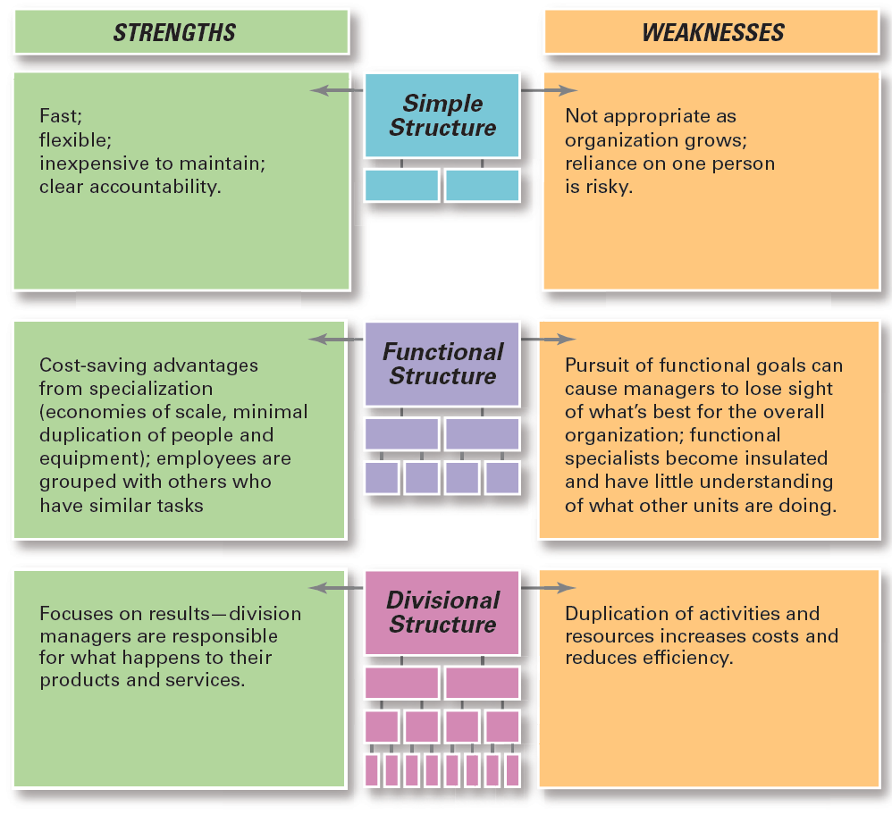
Exhibit 11-8 Traditional Organizational Designs
A summary of the strengths and weaknesses of each type of organizational design can be found in Exhibit 11-8.
Notes:
When designing a structure, managers may choose one of the traditional organizational designs. These structures tend to be more mechanistic in nature. A summary of the strengths and weaknesses of each type of organizational design can be found in Exhibit 11-8.

Slide 31
Team Structures
Team structure: an organizational structure in which the entire organization is made up of work teams
Notes:
In this structure, employee empowerment is crucial because no line of managerial authority flows from top to bottom. Rather, employee teams design and do work in the way they think is best, but the teams are also held responsible for all work performance results in their respective areas.

Slide 32
Matrix and Project Structures
Matrix structure: an organizational structure that assigns specialists from different functional departments to work on one or more projects
Project structure: an organizational structure in which employees continuously work on projects
Notes:
Other popular contemporary designs are the matrix and project structures. The matrix structure assigns specialists from different functional departments to work on projects led by a project manager (see Exhibit 11-9). One unique aspect of this design is that it creates a dual chain of command because employees in a matrix organization have two managers, their functional area manager and their product or project manager, who share authority.
Many organizations use a project structure, in which employees continuously work on projects. Unlike the matrix structure, a project structure has no formal departments where employees return at the completion of a project. Instead, employees take their specific skills, abilities, and experiences to other projects.

Slide 33
Exhibit 11-9 Example of a Matrix Organization
Exhibit 11-9 shows an example of a matrix organization.

Slide 34
The Boundaryless Organization
Boundaryless organization: an organization whose design is not defined by, or limited to, the horizontal, vertical, or external boundaries imposed by a predefined structure
Virtual organization: an organization that consists of a small core of full-time employees and outside specialists temporarily hired as needed to work on projects
Notes:
Although the idea of eliminating boundaries may seem odd, many of today’s most successful organizations find that they can operate most effectively by remaining flexible and unstructured: that the ideal structure for them is not having a rigid, bounded, and predefined structure.
The type of work virtual interns do typically involves “researching, sales, marketing, and social media development”—tasks that can be done anywhere with a computer and online access. Some organizations are structured in a way that allows most employees to be virtual employees.

Slide 35
Task Forces
Task force (or ad hoc committee): a temporary committee or team formed to tackle a specific short-term problem affecting several departments
Open innovation: opening up the search for new ideas beyond the organization’s boundaries and allowing innovations to easily transfer inward and outward
Notes:
Another structural option organizations might use is a task force (also called an ad hoc committee), a temporary committee or team formed to tackle a specific short-term problem affecting several departments. The temporary nature of a task force is what differentiates it from a cross-functional team.
The days may be numbered when businesses generate their own product development ideas and develop, manufacture, market, and deliver those products to customers. Today, many companies are trying open innovation, opening up the search for new ideas beyond the organization’s boundaries and allowing innovations to easily transfer inward and outward.

Slide 36
Exhibit 11-10 Benefits and Drawbacks of Open Innovation
Benefits | Drawbacks
Gives customers what they want—a voice | High demands of managing the process
Allows organizations to respond to complex problems | Extensive support needed
Nurtures internal and external relationships | Cultural challenges
Brings focus back to marketplace | Greater need for flexibility
Provides way to cope with rising costs and uncertainties of product development | Crucial changes required in how knowledge is controlled and shared
Notes:
Exhibit 11-10 describes some of the benefits and drawbacks of open innovation.
Sources: Based on S. Lindegaard, “The Side Effects of Open Innovation,” Bloomberg BusinessWeek online, June 7, 2010; H. W. Chesbrough and A. R. Garman, “How Open Innovation Can Help You Cope in Lean Times,” Harvard Business Review, December 2009, pp. 68–76; A. Gabor, “The Promise [and Perils] of Open Collaboration,” Strategy
& Business online, Autumn 2009; and J. Winsor, “Crowdsourcing: What It Means for Innovation,” BusinessWeek online, June 15, 2009.
e benefits and drawbacks of open innovation.

Slide 37
Telecommuting
Telecommuting: a work arrangement in which employees work at home and are linked to the workplace by computer
Notes:
Information technology has made telecommuting possible, and external environmental changes have made it necessary for many organizations.
Working from home used to be considered a “cushy perk” for a few lucky employees, and such an arrangement wasn’t allowed very often. Now, many businesses view telecommuting as a business necessity.
Despite its apparent appeal, many managers are reluctant to have their employees become “laptop hobos.” Employees often express the same concerns about working remotely, especially when it comes to the isolation of not being “at work.”

Slide 38
Compressed Workweeks, Flextime, and Job Sharing
Compressed workweek: a workweek where employees work longer hours per day but fewer days per week
Flextime (or flexible work hours): a scheduling system in which employees are required to work a specific number of hours a week but are free to vary those hours within certain limits
Job sharing: the practice of having two or more people split a full-time job
Notes:
Organizations may sometimes and they need to restructure work using forms of flexible work arrangements. One approach is a compressed workweek, a workweek where employees work longer hours per day but fewer days per week. The most common arrangement is four 10-hour days (a 4–40 program).
Another alternative is flextime (also known as flexible work hours), a scheduling system in which employees are required to work a specific number of hours a week but are free to vary those hours within certain limits. A flex-time schedule typically designates certain common core hours when all employees are required to be on the job, but allows starting, ending, and lunch-hour times to be flexible.
Organizations might offer job sharing to professionals who want to work but don’t want the demands and hassles of a full-time position. For instance, at Ernst & Young and Google, employees in many of the company’s locations can choose from a variety of flexible work arrangements, including job sharing. Also, many companies have used job sharing during the economic downturn to avoid employee layoffs.

Slide 39
The Contingent Workforce
Contingent workers: temporary, freelance, or contract workers whose employment is contingent on demand for their services
Notes:
According to the U.S. Bureau of Labor Statistics, contingent workers are persons who do not expect their jobs to last or who reported that their jobs are temporary. Also, they do not have an implicit or explicit contract for ongoing employment. Alternative employment arrangements include persons employed as independent contractors, on-call workers, temporary help agency workers, and workers provided by contract firms.
One of the main issues businesses face with their contingent workers, especially those who are independent contractors or freelancers, is classifying who actually qualifies as one. The decision on who is and who isn’t an independent contractor isn’t as easy or as unimportant as it may seem. Companies don’t have to pay Social Security, Medicare, or unemployment insurance taxes on workers classified as independent contractors. And those individuals also aren’t covered by most workplace laws. So it’s an important decision.

Slide 40
Review Learning Objective 11.1
Describe six key elements in organizational design.
1. Work specialization
2. Departmentalization
3. Chain of command
4. Span of control
5. Centralization/decentralization
6. Formalization
Notes:
Work specialization is dividing work activities into separate job tasks. Today’s view is that work specialization can help employees be more efficient. Departmentalization is how jobs are grouped together. Today most large organizations use combinations of different forms of departmentalization. The chain of command and its companion concepts—authority, responsibility, and unity of command—were viewed as important ways of maintaining control in organizations. The contemporary view is that they are less relevant in today’s organizations. The traditional view of span of control was that managers should directly supervise no more than five to six individuals. The contemporary view is that the span of control depends on the skills and abilities of the manager and the employees and on the characteristics of the situation. Centralization–decentralization is a structural decision about who makes decisions—upper-level managers or lower-level employees. Formalization concerns the organization’s use of standardization and strict rules to provide consistency and control. Today, organizations rely less on strict rules and standardization to guide and regulate employee behavior.

Slide 41
Review Learning Objective 11.2
Contrast mechanistic and organic structures.
Mechanistic structure: rigid, tightly controlled
Organic structure: highly adaptable, flexible
Notes:
A mechanistic organization is a rigid and tightly controlled structure. An organic organization is highly adaptive and flexible.

Slide 42
Review Learning Objective 11.3
Discuss the contingency factors that favor either the mechanistic model or the organic model of organizational design.
An organization’s structure should support the strategy.
Structure can be affected by size and technology.
Organic structure is most effective with unit production and process production technology.
Mechanistic structure is most effective with mass production technology.
Notes:
If the strategy changes, the structure also should change. An organization’s size can affect its structure up to a certain point. Once an organization reaches a certain size (usually around 2,000 employees), it’s fairly mechanistic. An organization’s technology can affect its structure. An organic structure is most e effective with unit production and process production technology. A mechanistic structure is most effective with mass production technology. The more uncertain an organization’s environment, the more it needs the flexibility of an organic design.

Slide 43
Review Learning Objective 11.4
Describe traditional organizational design options.
Simple structure: little departmentalization, wide spans of control, authority centralized in one person, and little formalization.
Functional structure
Divisional structure
Notes:
A simple structure is one with little departmentalization, wide spans of control, authority centralized in a single person, and little formalization. A functional structure groups similar or related occupational specialties together. A divisional structure is made up of separate business units or divisions.

Slide 44
Review Learning Objective 11.5
Discuss organizing for flexibility in the twenty-first century.
Structures:
Team
Matrix
Project
Boundaryless organization
Virtual organization
Compressed workweeks, flextime, job sharing
Contingent workforce
Notes:
In a team structure, the entire organization is made up of work teams. The matrix structure assigns specialists from different functional departments to work on one or more projects being led by project managers. A project structure is one in which employees continuously work on projects. A boundaryless organization’s design is not defined by, or limited by, the horizontal, vertical, or external boundaries imposed by a predefined structure. A virtual organization consists of a small core of full-time employees and outside specialists temporarily hired as needed to work on projects. Another structural option is a task force, which is a temporary committee or team formed to tackle a specific short-term problem affecting several departments.
Telecommuting is a work arrangement in which employees work at home and are linked to the workplace by computer. A compressed workweek is one in which employees work longer hours per day but fewer days per week. Flextime is a scheduling system in which employees are required to work a specific number of hours a week but are free to vary those hours within certain limits. Job sharing is when two or more people split a full-time job.
Contingent workers are temporary, freelance, or contract workers whose employment is contingent on demand for their services. Organizing issues include classifying who actually qualifies as an independent contractor; setting up a process for recruiting, screening, and placing contingent workers; and having a method in place for establishing goals, schedules, and deadlines and for monitoring work performance.

Slide 45
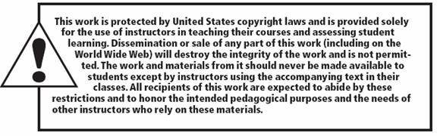
Copyright

